Slide 1
Training for Medical education via innovative eTechnology
MediTec
Kick off Meeting
23.02.2018

Slide 2
Subcontracting
Typical activities which may be sub-contracted are (provided they are not carried out by beneficiaries' staff: (person or org. from outside of the organization):
Organisation of Workshops
Evaluation activities and auditing
IT courses
Language courses
Printing, publishing and dissemination activities
Translation Services
Web design and maintenance
Installation of the Centers, cable laying,…….
Printing drafts of courses materials, presentation materials, trainings courses for students and staff members
Rules for subcontracting: needs as in Equipment when the contract >= 500,00 Euro
<500,00 Euro: needs contract between the two parties and paid invoices /
invoice from the 2nd party, in case of the transfer to the 2nd party
Please ask the coordinator!!!!

Slide 3
Co-Financing
Organising of meeting, booking, visit partners,..
Printing material for training, Organising of training for students and teachers (as invoices and staff reports)
Training for students in the centers (as staff reports)
Software for training of students in innovative medical technology and Update the bought software (invoices)
Visit partners (Travel reports)
Each partner have to present Co-financing

Slide 4
Travel to Slovakia, Malta, Czech and Germany
1-3 Staff member to Slovakia, Malta, Czech and Germany
3 Persons from PC, manager and 2 teachers / staff members
20 Students to Malta, 20 to Czech, 20 to Slaovakia
EU Partners: Use your Subcontracting for the training program, please ask the coordinator!!!

Slide 5
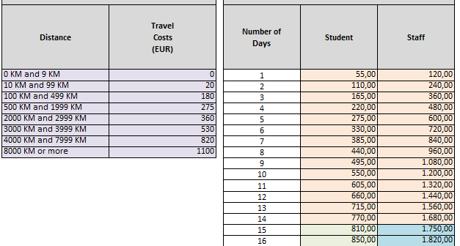
Travel Distance and Unit Cost

Slide 6
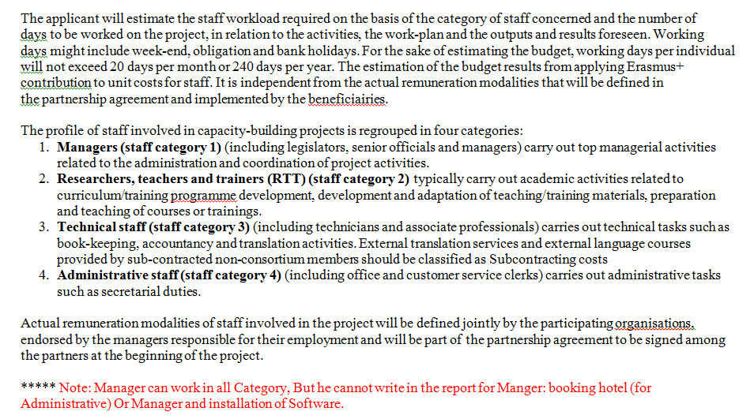

Slide 9
Thank you for attention

